Slide 1
Warning system for drivers

Slide 2
Abstract:
Over speed in the safety zone leads danger to the pedestrians.
This project is used to ensure the pedestrian safety and vehicle speed limits in safety zones. (school and hospital zones)
It indicates while car is travelling in over speed and near by pedestrians.
It helps to prevent the accidents while travelling in satey zones.

Slide 3
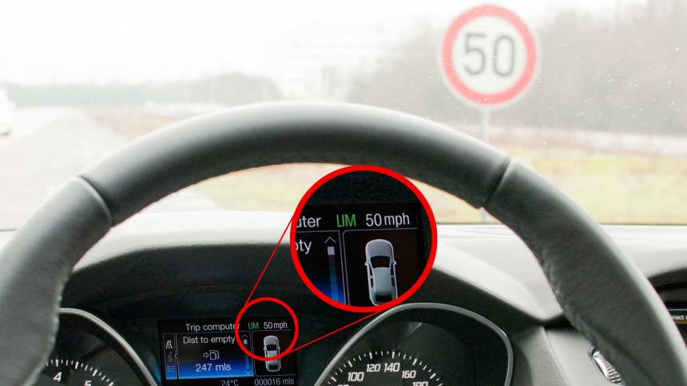
Model for this device:

Slide 4
Flow of working
1
The traffic signs nearby safety zones(Schools and Hospitals) are read by “IMAGE PROCESSING using RASPBERRY PI” and “Camera Module”.
2
The Speed of the Vehicle is sensed using “LM393 Speed Sensor”.
3
If the vehicle goes high speed or if any pedestrian crossing the road, a warning indication given to the driver to go with a low speed through “LCD Display” along with a “Buzzer”

Slide 5
Components:
Raspberry Pi
LCD display

